Slide 1
Programming Language Syntax and Semantics
PRINCIPLES OF PROGRAMMING LANGUAGES
UNIT -I
PPL - SE SEM II (2106-17)

Slide 2
Software Development Process
Also called SDLC ( Software Development Life Cycle)
Framework defining tasks performed at each step in the software development process.
ISO/IEC 12207 is an international standard for software life-cycle processes.

Slide 3
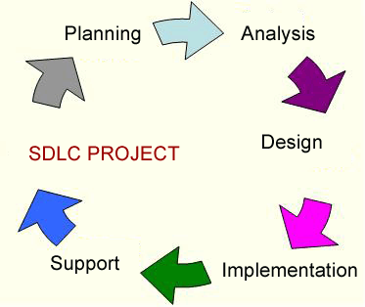
Conti…
A typical Software Development life cycle consists of the following stages:

Slide 4
SDLC models
Waterfall Model
Iterative and Incremental Method
Spiral Method (SDM)
V-Model
Agile development
Evolutionary Prototyping Model
Big Bang Model

Slide 5
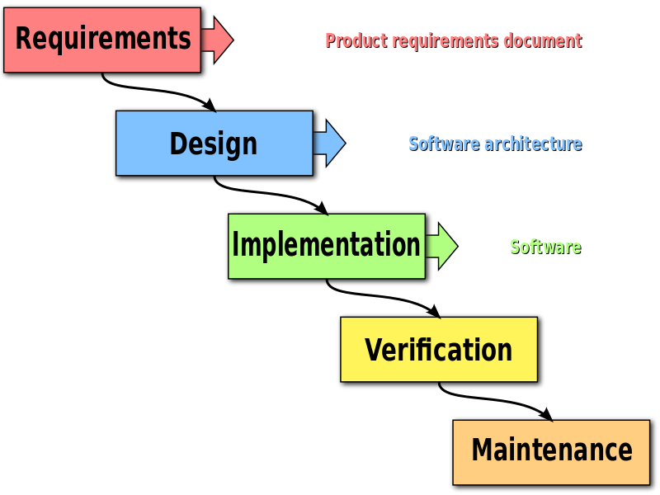
SDLC Waterfall Model
progress is seen as flowing steadily downwards (like a waterfall)

Slide 6
Requirement Analysis & Specification
Requirements analysis
Process of determining user expectations for a new or modified product.
Requirements must be quantifiable, relevant and detailed.
In software engineering, such requirements are often called functional specifications

Slide 7
Requirements specification is often done by business analysts-
Their primary role is to establish communication with the client and produce a document that is signed off and will be used as a “bible” of what should be designed by architects and coded by developers.
Requirement specification is most crucial phase of an average software project.
Its about effective communication:
1.Between developer and client about what the product should do.
2.Between the requirements team and the design team, about the client's needs.

Slide 8
Software Design
The requirement specifications from first phase are studied in this phase system design is prepared.
System Design helps in specifying hardware and system requirements and also helps in defining overall system architecture.
Making distinction between What the problem and how to solve problem.
To provide decomposition into modules that will meet stated requirements.
Design method followed affects the quality of application and also choice of PL to be used.

Slide 9
Implementation ( Coding)
Physical system specifications are converted into a working and reliable solution.
Here system is developed. It is followed by testing & implementation.
Coding: Implementation of the design specified in the design document into executable programming language code.
The output of the coding phase is the source code for the software that acts as input to the testing and maintenance phase.

Slide 10
Integration and Testing
Includes detection of errors in the software.
Test plan that recognizes test-related activities, such as test case generation, testing criteria, and resource allocation for testing. The code is tested and mapped against the design document created in the design phase.
The output of the testing phase is a test report containing errors that occurred while testing the application.
Installation: In this stage the new system is installed and rolled out.

Slide 11
Verification & Validation
Process of checking that a software system meets specifications and that it fulfills its intended purpose.
Responsibility of software testers as part of the SDLC.
Software verification :
"Assuming we should build X, does our software actually achieve its goals without any bugs or gaps?"
Are we building the product right?
Products of a given development phase satisfy the conditions imposed at the start of that phase.
Notes:
Process of checking that a software system meets specifications and that it fulfills its intended purpose. It may also be referred to as software quality control. It is normally the responsibility of software testers as part of the software development lifecycle.
Software verification is: "Assuming we should build X, does our software actually achieve its goals without any bugs or gaps?"
Software validation is: "Was X actually what we should have built? Does X actually meet the high level requirements?“
Validation checks that the product design satisfies or fits the intended use (high-level checking), i.e., the software meets the user requirements. This is done through dynamic testing and other forms of review.
Verification: Are we building the product right?
Validation: Are we building the right product?
Software Verification: Products of a given development phase satisfy the conditions imposed at the start of that phase.
Software Validation: Process to determine whether it satisfies specified requirements.

Slide 12
Software validation:
Are we building the right product?
Process to determine whether it satisfies specified requirements
"Was X actually what we should have built? Does X actually meet the high level requirements?“
Validation checks that the product design satisfies or fits the intended use (high-level checking), i.e., the software meets the user requirements. This is done through dynamic testing.

Slide 13

Maintenance
The Maintenance Phase occurs once the system is operational.
It includes implementation of changes that software might undergo over a period of time, or implementation of new requirements after the software is deployed at the customer location.
It also includes handling the residual errors that may exist in the software even after the testing phase.

Slide 14
This phase also monitors system performance, rectifies bugs and requested changes are made.
Key points
Keep system live
Maintain code
Update software when required

Slide 15
Waterfall Strengths
Easy to understand, easy to use
Provides structure to inexperienced staff
Milestones are well understood
Sets requirements stability
Good for management control (plan, staff, track)
Works well when quality is more important than cost or schedule

Slide 16
Waterfall Deficiencies
All requirements must be known upfront
Deliverables created for each phase are considered frozen – inhibits flexibility
Can give a false impression of progress
Does not reflect problem-solving nature of software development – iterations of phases
Integration is one big bang at the end
Little opportunity for customer to preview the system (until it may be too late)

Slide 17
Models description
V- model
Verification and Validation model.
Like waterfall model
Testing of the product is planned in parallel with a corresponding phase of development .
Incremental model
“multi-waterfall” cycle.
Cycles are divided up into smaller, more easily managed modules.
Each module passes through the requirements, design, implementation and testing phases.
Total cost is higher than waterfall.

Slide 18
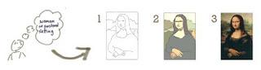
RAD model- Rapid Application Development
components or functions are developed in parallel as if they were mini projects
developments are time boxed, delivered and then assembled into a working prototype
Iterative Model
create rough product or product piece in one iteration, then review it and improve it in next iteration and so on until it’s finished.

Slide 19
Agile model
combination of iterative and incremental model
Used for time critical applications
break the product into small incremental builds.
Big Bang Model
requirements are understood and implemented as they come
ideal for small projects with one or two developers working together

Slide 20
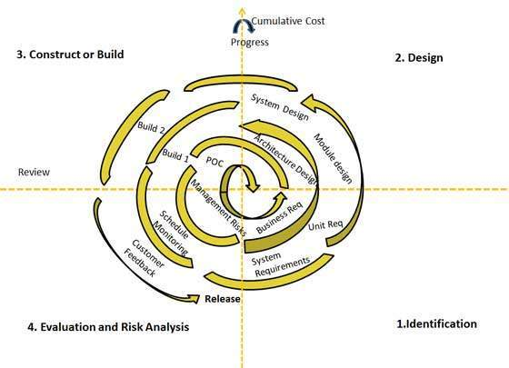
Spiral Model
Allows for incremental releases of the product, or incremental refinement through each iteration around the spiral.
Spiral model has four phases-

Slide 21
Software Development Environment
The development environment is the set of processes and programming tools used to create the program or software product.
An IDE (integrated development environment) is one in which the processes and tools are coordinated to provide developers an orderly interface to and convenient view of the development process.

Slide 22
IDE Examples
NetBeans,
Eclipse,
IntelliJ ,
Visual Studio
Eclipse, SlickEdit, ActiveState Komodo, IntelliJ IDEA, MyEclipse, Oracle JDeveloper, NetBeans, Codenvy and Microsoft Visual Studio. Xcode, Xojo and Delphi

Slide 23
Software Design Methods
Some languages provide better support for some design methods than others.
FORTRAN- makes it difficult to systematically design algorithms in a top-down fashion
Pascal – designed with explicit goal of supporting top-down program development and structured programming
Difficult with both to
“ decompose a software system into abstract data types”
lack of constructs to define modules other than routines

Slide 24
SDM Count…
To understand the relationship between a programming language and a design method it is important to realize programming paradigm.
Programming Paradigm = Programming Style
Smalltalk and Eiffel are object-oriented languages
FORTRAN and Pascal are procedural languages

Slide 25
SDM Count…
Guide software designers in a system’s decomposition into logical components
Procedural design method guides in decomposing system into modules that realize abstract operations that may be activated by other procedural modules.
Object-oriented method guides in decomposing system into classes of objects.
Design method and the paradigm supported
by the language should be the same

Slide 26
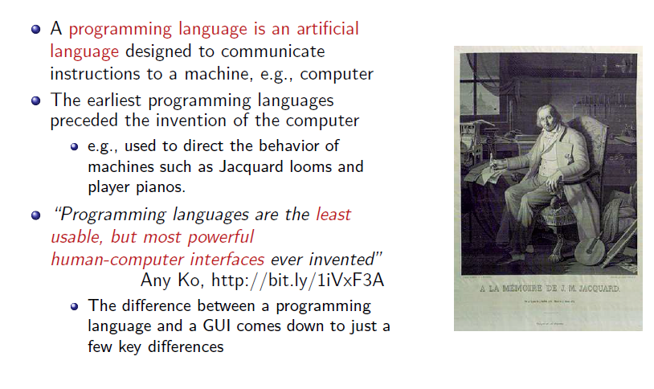
Programming Languages

Slide 27
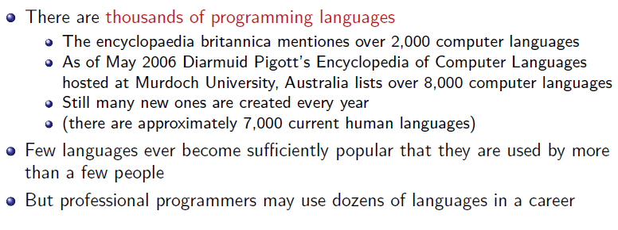
How Many Programming Languages Exist

Slide 28
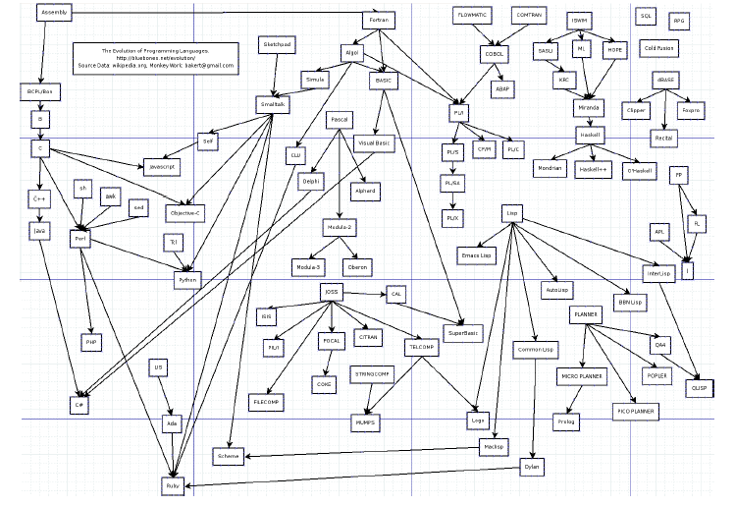
How Many Programming Languages Exist

Slide 29
Programming Language Paradigms

Slide 30
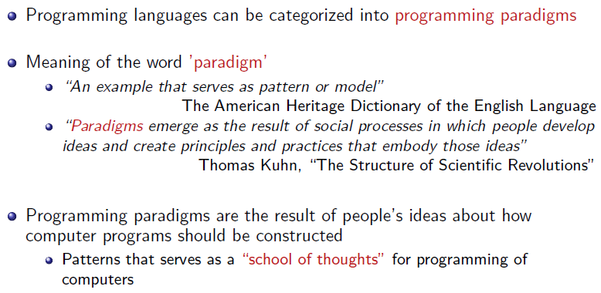
Programming Paradigms

Slide 31
Programming Language Paradigms
Unit of Modularization

Slide 32
Procedural Programming
Conventional programming style
Programs are decomposed into computation steps
Each perform complex operations.
Procedures and functions (collectively called routines) are used as modularization units
Example : Fortran, ALGOL, COBOL and BASIC.

Slide 33
Functional Programming
Rooted in the theory of mathematical functions.
It emphasizes the use of expressions & functions.
Functions are the primary building blocks of the program.
passed freely as parameters
constructed and
returned as result parameters of other function
Example: ML, Common Lisp, Scheme, Clojure

Slide 34
Abstract Data Type Programming
Abstract data types as the unit
CLU was the first language designed

Slide 35
Module-based Programming
Unit as groupings of entities such as variables, procedures, functions, types, etc
Program is composed of a set of such modules
Modules can be used to define precisely which services are exported to the outside world by module.
Examples: Modula-2 , Ada

Slide 36
Object-oriented Programming
Emphasizes the definition of classes of objects
This based upon hierarchies of classes and
Run-time selection of units to execute.
Examples: Smalltalk, Eiffel , C++, Ada 95

Slide 37
Generic Programming
Emphasize the definition of generic modules
Modules can be instantiated, either at compile-time or runtime.
To create the entities—data structures, functions, and procedures etc.
Encourages the development of high-level, generic, abstractions as units of modularity
Does not exist in isolation
Exist jointly with OOP as in Eiffel
With functional programming as in ML.
With more than one paradigm, like ada and c++.

Slide 38
Declarative Programming
Emphasizes the declarative description of a problem
programs are close to a specification.
Examples:
Logic languages, like PROLOG, and
rule-based languages, like OPS5 and KEE

Slide 39
Language and computer architecture
Von-Neumann Computer Architecture

Slide 40

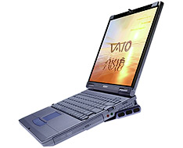
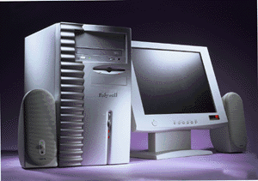
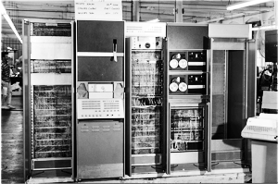
Designing Computers
All computers more or less based on the same basic design, the Von Neumann Architecture!

Slide 41
The Von Neumann Architecture
Model for designing and building computers, based on the following three characteristics:
The computer consists of four main sub-systems:
Memory
ALU (Arithmetic/Logic Unit)
Control Unit
Input/Output System (I/O)
Program is stored in memory during execution.
Program instructions are executed sequentially.

Slide 42
The Von Neumann Architecture
Bus
Memory
Processor (CPU)
Input-Output
Control Unit
ALU
Communicate with
"outside world", e.g.
Screen
Keyboard
Storage devices
...
Store data and program
Execute program
Do arithmetic/logic operations requested by program

Slide 43
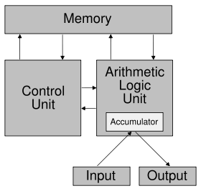
Simplified Architecture

Slide 44
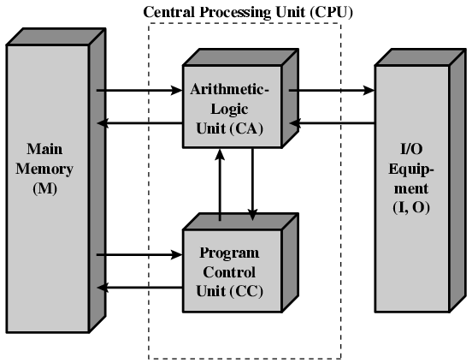

Slide 45
Memory Subsystem
Memory, also called RAM (Random Access Memory),
Consists of many memory cells (storage units) of a fixed size. Each cell has an address associated with it: 0, 1, …
All accesses to memory are to a specified address. A cell is the minimum unit of access (fetch/store a complete cell).
The time it takes to fetch/store a cell is the same for all cells.
When the computer is running, both
Program
Data (variables)
are stored in the memory.

Slide 46
RAM
N
Need to distinguish between
the address of a memory cell and the content of a memory cell
Memory width (W):
How many bits is each memory cell, typically one byte (=8 bits)
Address width (N):
How many bits used to represent each address, determines the maximum memory size = address space
If address width is N-bits, then address space is 2^{N} (0,1,...,2^{N}-1)
0000000000000001
1 bit
0
1
2
...
2^{N}
2^{N}-1
W
46

Slide 47
Memory Size / Speed
Typical memory in a personal computer (PC):
64MB - 256MB
Memory sizes:
Kilobyte (KB) = 2¹⁰ =1,024 bytes ~ 1 Thousand
Megabyte(MB)= 2²⁰ =1,048,576 bytes ~ 1 million
Gigabyte(GB) = 2³⁰ = 1,073,741,824 bytes ~ 1 billion
Memory Access Time (read from/ write to memory)
50-75 nanoseconds (1 nsec. = 0.000000001 sec.)
RAM is
volatile (can only store when power is on)
relatively expensive

Slide 48
Operations on Memory
Fetch (address):
Fetch a copy of the content of memory cell with the specified address.
Non-destructive, copies value in memory cell.
Store (address, value):
Store the specified value into the memory cell specified by address.
Destructive, overwrites the previous value of the memory cell.
The memory system is interfaced via:
Memory Address Register (MAR)
Memory Data Register (MDR)
Fetch/Store signal

Slide 49
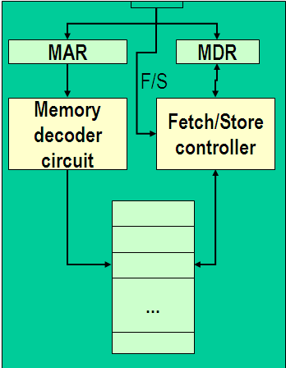
Structure of the Memory Subsystem
Fetch(address)
Load address into MAR.
Decode the address in MAR.
Copy the content of memory cell with specified address into MDR.
Store(address, value)
Load the address into MAR.
Load the value into MDR.
Decode the address in MAR
Copy the content of MDR into memory cell with the specified address.

Slide 50
Input/Output Subsystem
Handles devices that allow the computer system to:
Communicate and interact with the outside world
Screen, keyboard, printer, ...
Store information (mass-storage)
Hard-drives, floppies, CD, tapes, …
Mass-Storage Device Access Methods:
Direct Access Storage Devices (DASDs)
Hard-drives, floppy-disks, CD-ROMs, ...
Sequential Access Storage Devices (SASDs)
Tapes (for example, used as backup devices)

Slide 51
I/O Controllers
Speed of I/O devices is slow compared to RAM
RAM ~ 50 nsec.
Hard-Drive ~ 10msec. = (10,000,000 nsec)
Solution:
I/O Controller, a special purpose processor:
Has a small memory buffer, and a control logic to control I/O device (e.g. move disk arm).
Sends an interrupt signal to CPU when done read/write.
Data transferred between RAM and memory buffer.
Processor free to do something else while I/O controller reads/writes data from/to device into I/O buffer.

Slide 52
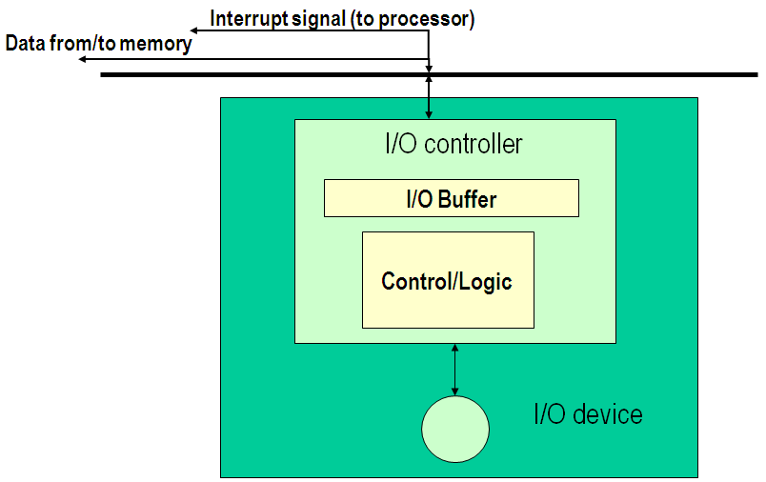
Structure of the I/O Subsystem

Slide 53
The ALU Subsystem
The ALU (Arithmetic/Logic Unit) performs
mathematical operations (+, -, x, /, …)
logic operations (=, <, >, and, or, not, ...)
In today's computers integrated into the CPU
Consists of:
Circuits to do the arithmetic/logic operations.
Registers (fast storage units) to store intermediate computational results.
Bus that connects the two.

Slide 54
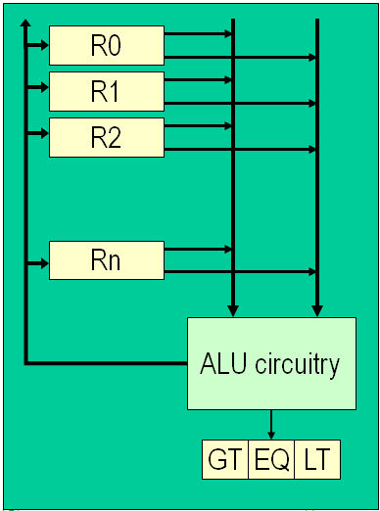
Structure of the ALU
Registers:
Very fast local memory cells, that store operands of operations and intermediate results.
CCR (condition code register), a special purpose register that stores the result of <, = , > operations
ALU circuitry:
Contains an array of circuits to do mathematical/logic operations.
Bus:
Data path interconnecting the registers to the ALU circuitry.

Slide 55
The Control Unit
Program is stored in memory
as machine language instructions, in binary
The task of the control unit is to execute programs by repeatedly:
Fetch from memory the next instruction to be executed.
Decode it, that is, determine what is to be done.
Execute it by issuing the appropriate signals to the ALU, memory, and I/O subsystems.
Continues until the HALT instruction

Slide 56
Machine Language Instructions
A machine language instruction consists of:
Operation code, telling which operation to perform
Address field(s), telling the memory addresses of the values on which the operation works.
Example: ADD X, Y (Add content of memory locations X and Y, and store back in memory location Y).
Assume: opcode for ADD is 9, and addresses X=99, Y=100
00001001
0000000001100011
0000000001100100
Opcode (8 bits)
Address 1 (16 bits)
Address 2 (16 bits)

Slide 57
Instruction Set Design
Two different approaches:
Reduced Instruction Set Computers (RISC)
Instruction set as small and simple as possible.
Minimizes amount of circuitry --> faster computers
Complex Instruction Set Computers (CISC)
More instructions, many very complex
Each instruction can do more work, but require more circuitry.

Slide 58
Typical Machine Instructions
Notation:
We use X, Y, Z to denote RAM cells
Assume only one register R (for simplicity)
Use English-like descriptions (should be binary)
Data Transfer Instructions
LOAD X Load content of memory location X to R
STORE X Load content of R to memory location X
MOVE X, Y Copy content of memory location X to loc. Y (not absolutely necessary)

Slide 59
Machine Instructions (cont.)
Arithmetic
ADD X, Y, Z CON(Z) = CON(X) + CON(Y)
ADD X, Y CON(Y) = CON(X) + CON(Y)
ADD X R = CON(X) + R
similar instructions for other operators, e.g. SUBTR,OR, ...
Compare
COMPARE X, Y Compare the content of memory cell X to the content of memory cell Y and set the condition codes (CCR) accordingly.
E.g. If CON(X) = R then set EQ=1, GT=0, LT=0

Slide 60
Machine Instructions (cont.)
Branch
JUMP X Load next instruction from memory loc. X
JUMPGT X Load next instruction from memory loc. X only if GT flag in CCR is set, otherwise load statement from next sequence loc. as usual.
JUMPEQ, JUMPLT, JUMPGE, JUMPLE,JUMPNEQ
Control
HALT Stop program execution.

Slide 61
Example
Pseudo-code: Set A to B + C
Assuming variable:
A stored in memory cell 100, B stored in memory cell 150, C stored in memory cell 151
Machine language (really in binary)
LOAD 150
ADD 151
STORE 100
or
(ADD 150, 151, 100)

Slide 62
Structure of the Control Unit
PC (Program Counter):
stores the address of next instruction to fetch
IR (Instruction Register):
stores the instruction fetched from memory
Instruction Decoder:
Decodes instruction and activates necessary circuitry
PC
IR
+1
Instruction
Decoder

Slide 63
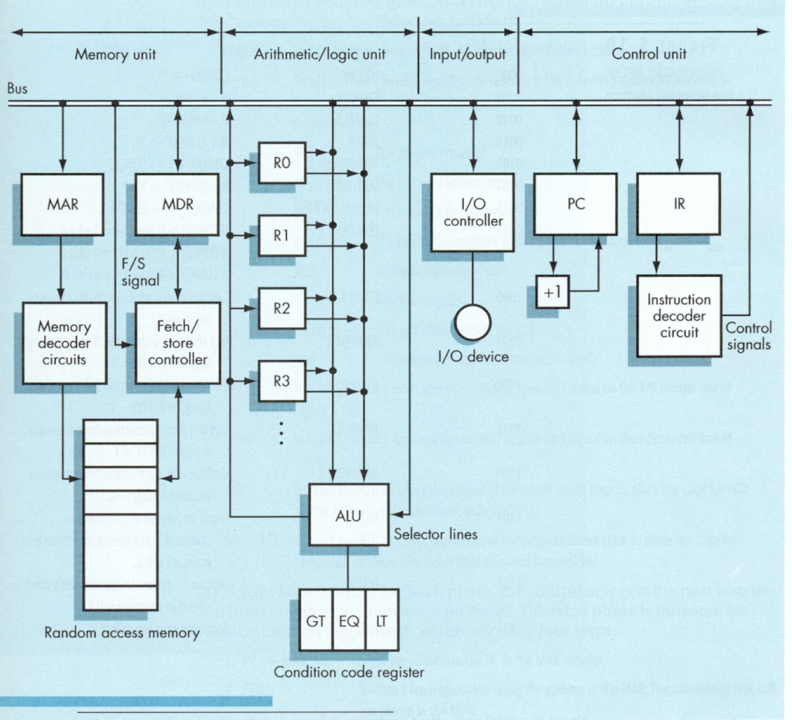
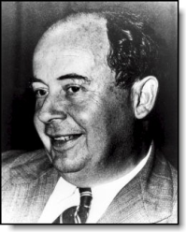
von Neumann
Architecture

Slide 64
How does this all work together?
Program Execution:
PC is set to the address where the first program instruction is stored in memory.
Repeat until HALT instruction or fatal error
Fetch instruction
Decode instruction
Execute instruction
End of loop

Slide 65
Program Execution (cont.)
Fetch phase
PC --> MAR (put address in PC into MAR)
Fetch signal (signal memory to fetch value into MDR)
MDR --> IR (move value to Instruction Register)
PC + 1 --> PC (Increase address in program counter)
Decode Phase
IR -> Instruction decoder (decode instruction in IR)
Instruction decoder will then generate the signals to activate the circuitry to carry out the instruction

Slide 66
Program Execution (cont.)
Execute Phase
Differs from one instruction to the next.
Example:
LOAD X (load value in addr. X into register)
IR_address -> MAR
Fetch signal
MDR --> R
ADD X
left as an exercise
Notes:
CMPUT101 Introduction to Computing - Spring 2001
Chapter 5 The Von Neumann Architecture
66

Slide 67
Instruction Set for Our Von Neumann Machine
Opcode | Operation | Meaning
0000 | LOAD X | CON(X) --> R
0001 | STORE X | R --> CON(X)
0010 | CLEAR X | 0 --> CON(X)
0011 | ADD X | R + CON(X) --> R
0100 | INCREMENT X | CON(X) + 1 --> CON(X)
0101 | SUBTRACT X | R - CON(X) --> R
0101 | DECREMENT X | CON(X) - 1 --> CON(X)
0111 | COMPARE X | If CON(X) > R then GT = 1 else 0 If CON(X) = R then EQ = 1 else 0 If CON(X) < R then LT = 1 else 0
1000 | JUMP X | Get next instruction from memory location X
1001 | JUMPGT X | Get next instruction from memory loc. X if GT=1
... | JUMPxx X | xx = LT / EQ / NEQ
1101 | IN X | Input an integer value and store in X
1110 | OUT X | Output, in decimal notation, content of mem. loc. X
1111 | HALT | Stop program execution
Notes:
CMPUT101 Introduction to Computing - Spring 2001
Chapter 5 The Von Neumann Architecture
67

Slide 68
Programming Languages
What is programming language?
Need of programming Language.
Role of programming Language.
Evaluation history of programming language.

Slide 69
? What is Programming Language
Tool for writing software.
computer language designed to communicate instructions to a machine
programs to control the behavior of a machine
Notation for description of algorithm & data structure.

Slide 70
Why study programming languages?
Increased capacity to express idea
To allow better choice of programming language
Increased ability to learn new language
Increased ability to design new language
To increase vocabulary of useful programming construct.

Slide 71
Need to Study Programming languages
Increased capacity to express ideas:
The language places limits on the kinds of control structures, data structures, and abstractions can use; thus the forms of algorithms they can construct are also limited.
Awareness of a wider variety of programming language features can reduce such limitations in software development
Builds an appreciation for valuable language features and encourages programmers to use them
Notes:
The language in which programmers develop software places limits on the kinds of control structures, data structures, and abstractions they can use; thus the forms of algorithms they can construct are also limited.
Awareness of a wider variety of programming language features can reduce such limitations in software development.
The study of programming language concepts builds an appreciation for valuable language features and encourages programmers to use them.

Slide 72
Improved background for choosing appropriate languages
Allow the choice of just the right language for a particular project, thereby reducing the required coding effort.
Example how data is going to stored in array?
Notes:
A knowledge of a variety of languages may allow the choice of just the right language for a particular project, thereby reducing the required coding effort.
Example how data is going to stored in array?

Slide 73
Increased ability to learn new languages
A thorough knowledge of a variety of programming language constructs and implementation techniques allows the programmer to learn a new programming language more easily when the need arises.

Slide 74
3. Better understanding of the significance of implementation. OR
To improve your use of your existing programming language:
Implementation issue allows us to visualize how a computer executes various language constructs.
This in turn fosters an understanding of the relative efficiency of alternative constructs that may be chosen for a program.

Slide 75
Increased ability to design new languages:
Many languages are based on C or Pascal as implementation models.
This aspect of program design is simplified if the programmer is familiar with a variety of constructs and implementation methods from ordinary programming languages.

Slide 76
To improve your ability to develop effective algorithms
Allows the programmer to understand the relative cost of feature in a particular language and from this understanding to determine whether its use is warranted in a particular programming situation.

Slide 77
To increase your vocabulary of useful programming constructs.
Familiarity with a single programming language tends to have a similar constraining effect.
By studying the constructs provided by a wide range of languages, a programmer increases his programming vocabulary.

Slide 78
Attributes of Good Programming Language

Slide 79
Important Criteria for good language design/Attribute of good Prog. Language
Writability
Readability
Overall simplicity
Control statement
Data types and structure
Syntax design
Orthogonality
Reliability
uniformity
Maintainability
Standard ability
implement ability

Slide 80
Programming language Qualities
As quality of language must be related to quality of software …
Reliability : Software must be Reliable.
Maintainability : Software must be maintainable.
Efficiency : Software must execute efficiently.

Slide 81
Characteristics of Good Programming Languages
Language & Reliability
Writ ability
Concentrate on problem solving activity with less error-prone.
Readability
It should able to follow logic of program& discover presence of errors.
Clarity, Simplicity, and Unity
A PL should provide a clear, simple and unified set of concepts that can be used as primitives in developing algorithms.
Notes:
Several characteristics believed to be important for making a programming language good are:
Simplicity : A good programming language must be simple and easy to learn and use. It should provide a programmer with a clear, simple and unified set of concepts, which can be easily grasped. The overall simplicity of a programming language strongly affects the readability of the programs written in that language, and programs, which are easier to read and understand, are also easier to maintain. It is also easy to develop and implement a compiler or an interpreter for a programming language, which is simple. However, the power needed for the language should not be sacrificed for simplicity.
Naturalness:- A good language should be natural for the application area, for which it has been designed. That is, it should provide appropriate operators, data structures, control structures, and a natural syntax to facilitate the users to code their problem easily and efficiently.
Abstraction:- Abstraction means the ability to define and then use complicated structures or operations in ways that allow many of the details to be ignored. The degree of abstraction allowed by a programming language directly effects its writ ability. Object oriented language support high degree of abstraction. Hence, writing programs in object oriented language is much easier. Object oriented language also support re usability of program segments due to this features.
Efficiency :- Programs written in a good programming language are efficiently translated into machine code, are efficiently executed, and acquire as little space in the memory as possible. That is a good programming language is supported with a good language translator which gives due consideration to space and time efficiency.
Structured:- Structured means that the language should have necessary features to allow its users to write their programs based on the concepts of structured programming. This property of a moreover, it forces a programmer to look at a problem in a logical way, so that fewer errors are created while writing a program for the problem.
Compactness :- In a good programming language, programmers should be able to express intended operations concisely. A verbose language is generally not liked by programmers, because they need to write too much.
Locality :- A good programming language should be such that while writing a programmer concentrate almost solely on the part of the program around the statement currently being worked with.

Slide 82
Safety
Language should not provide feature that write harmful programs. goto statement or pointer variables.
Naturalness
Language should be natural for the application area, for which it has been designed. i.e. it should provide appropriate operators, data structures, control structures, and a natural syntax to facilitate the users to code their problem easily and efficiently.

Slide 83
Orthogonality:
The term orthogonality refers to the attribute of being able to combine various features of a language in all possible combinations, with every combination being meaningful.
When the features of a language are orthogonal, the language is easier to learn and programs are easier to write.

Slide 84
The negative aspect of orthogonality is that a program will often compile without errors even though it contains a combination of features that are logically incoherent or extremely inefficient to execute.

Slide 85
2. Language & Maintainability
Factoring
Language should allow to factor related features into one single unit. Program become more readable and modifiable.
Locality
The effect of language feature is restricted to small, local portion of entire program.
Factoring promotes locality i.e. changes may apply only to factoring portion.

Slide 86
3. Languages and Efficiency
Efficiency is no longer measured only by the execution speed and space.
Components of the efficiency measure
Effort required to produce a program or system initially
Effort required in maintenance
May concerned with productivity of the software development process than the performance of the resulting products.

Slide 87
One might be interested in developing software components that might be reusable in future similar applications.
One might be interested in developing portable software.
Efficiency is often a combined quality of both the language and its implementation.
The language adversely affects efficiency if
It disallows certain optimizations to be applied by the compiler.

Slide 88
x = fun (y) + z + fun (y);
in C cannot be optimized as
x = 2* fun (y) + z;
which would cause just one call to function fun.
The language can affect efficiency
Example:
by allowing multithreaded concurrent computations.
if–say–it does not reuse memory space after it is released by the program

Slide 89
Role of Programming Languages

Slide 90
1. Computer capabilities
Computers have evolved from the small, slow, and costly vacuum-tube machines of the 1950’s to the supercomputers and the microcomputers of today.
At the same time, layers of operating system software have been inserted between the programming language and the underlying computer hardware.
These factors have influenced both the structure and the cost of using the features of high-level languages.

Slide 91
2. Applications
Computer use has spread rapidly from the original concentration on military, scientific, business, and industrial applications to the computer games, PCs, Internet, and applications in every area of human activity seen today.
The requirements of new application areas affect the design of new languages.

Slide 92
3. Programming Methods
The use of the programming method depend upon the size and complexity of the program.
Language design have evolved to reflect our changing understanding of good methods for writing large and complex programs and to reflect the changing environment in which programming is done.

Slide 93
4. Implementation Methods
The development of better implementation methods has affected the choice of features to include in language designs.

Slide 94
5. Theoretical Studies
Research into the conceptual foundations for language design and implementation, using formal mathematical methods, has increased our understanding of the strengths and weaknesses of language features, which has influenced the inclusion of these features in new language design.

Slide 95
6. Standardization
The need for standard languages that can be implemented easily on a variety of computer systems, which allow programs to be transported from one computer to another, has provided a strong conservative influence on the evolution of language designs.

Slide 96
Portability of programs
A language that is widely available and whose definition is independent of the features of a particular machine forms a useful base for the production of transportable programs.

Slide 97
Cost of use
The ultimate total cost of programming language is a function of many of its characteristics as given below.
Cost of program execution
Cost of program translation
Cost of program creation, testing and use
Cost of program maintenance

Slide 98
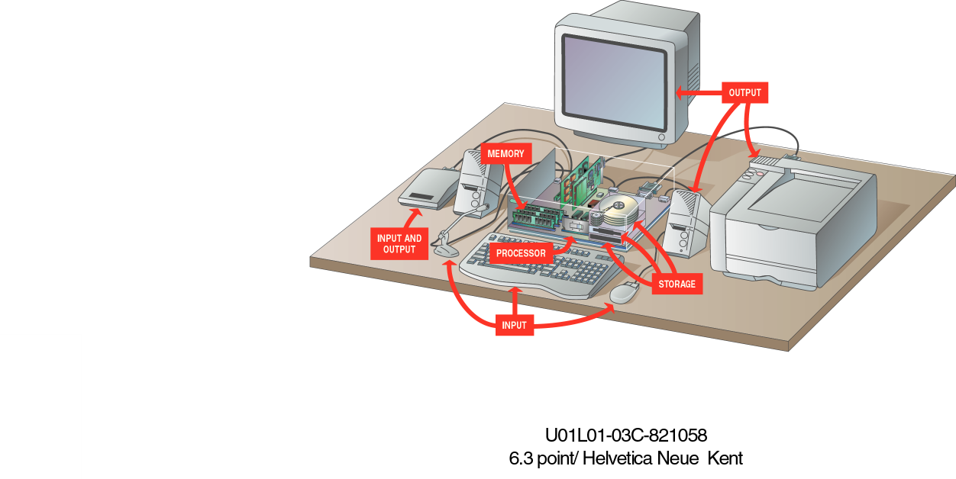
Evolution and History of Programming Languages Software/Hardware/System

Slide 99
The Evolution of Programming Languages
To build programs, people use languages that are similar to human language. The results are translated into machine code, which computers understand.
Programming languages fall into three broad categories:
Machine languages
Assembly languages
Higher-level languages

Slide 100
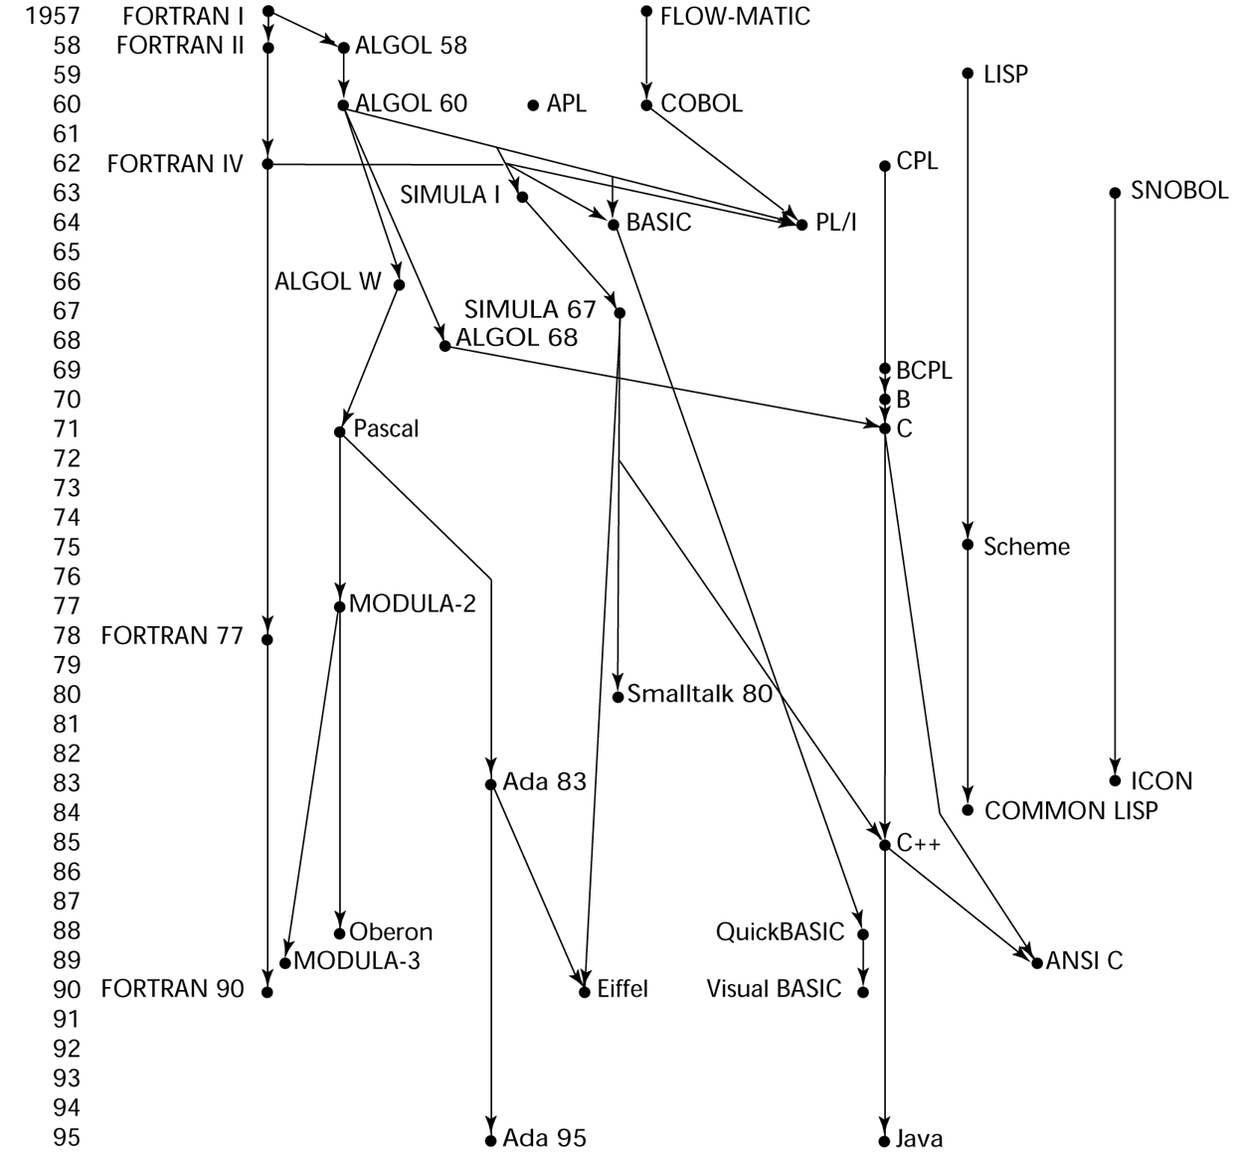
History Timeline
History Timeline
Notes:
The Tower of Babel
Genesis 11:1-7
Now the whole earth had one language and few words.
And as men migrated from the east, they found a plain in the land of Shinar and settled there. And they said to one another, "Come, let us make bricks, and burn them thoroughly." And they had brick for stone, and bitumen for mortar.
Then they said, "Come, let us build ourselves a city, and a tower with its top in the heavens, and let us make a name for ourselves, lest we be scattered abroad upon the face of the whole earth."
And the Lord came down to see the city which the sons of men had built.
And the Lord said, "Behold, they are one people, and they all have one language; and this is only the beginning of what they will do; and nothing that they propose to do will now be impossible for them.
"Come, let us go down, and there confuse their language, that they may not understand one another's speech."
So the Lord scattered them abroad from there over the face of all the earth, and they left off building the city.
Therefore its name was called Babel, because the Lord confused the language of all the earth; and from there the Lord scattered them abroad over the face of all the earth.

Slide 101
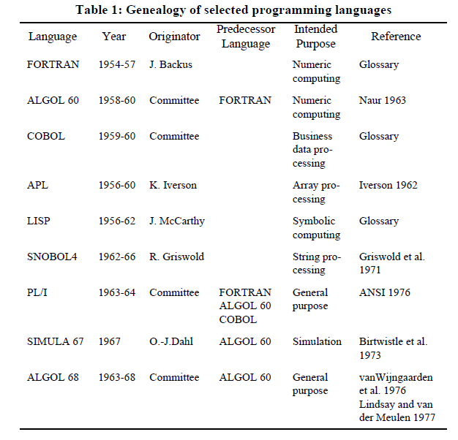

Slide 102
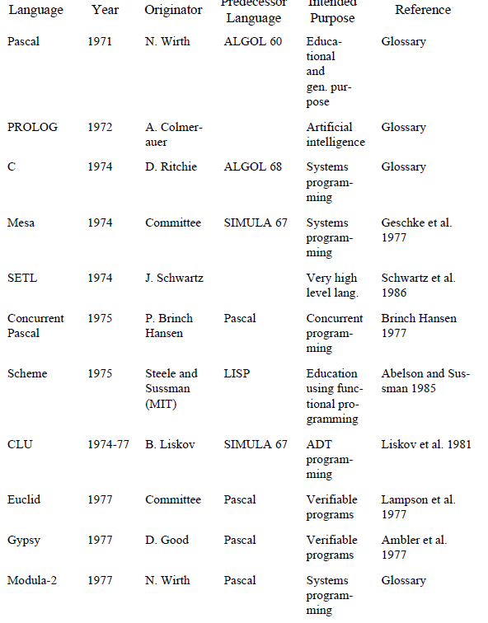

Slide 103
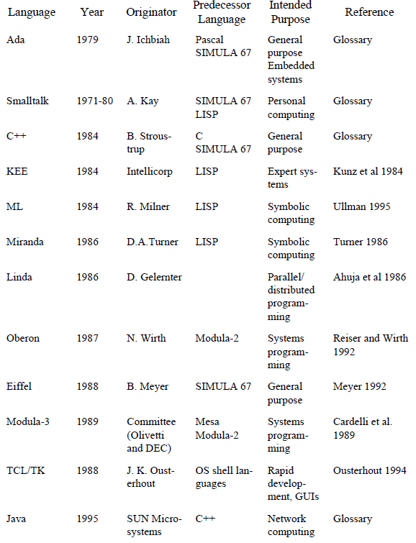

Slide 104
FORTRAN- Formula Translation
COBOL- Common Business Oriented Language
ALGOL- Algorithmic Languages
LISP- List Processing
APL- A Programming Language
PL/1= Programming Language 1
Prolog-Programming in Logic
ML- Meta Language
SNOBOL- String Oriented Symbolic Language

Slide 105
Early High Level Languages : FORTRAN, ALGOL 60, and COBOL
Early 1950s
Major achievements as technically sound and economically viable.
Hardware was very expensive
Execution efficiency concerns were the dominant design constraint

Slide 106
FORTRAN
Introduced modularity via separately developed and compiled subprograms and possible sharing of data among modules via a global (COMMON) environment.
ALGOL 60
Introduced the notion of block structure and recursive procedures.
COBOL
Introduced files and data descriptions.
Managing Inventories and payrolls.

Slide 107
Early schisms: LISP, APL, and SNOBOL4
Early 1960s
Attempts to define programming languages whose computation model could be based on some well-characterized mathematical principles, rather than on for efficiency of implementation.
LISP, APL, and SNOBOL4 are heavy consumers of machine resources (time and space).
Are mostly oriented towards numerical problem-solving.

Slide 108
LISP
Based upon the theory of recursive functions and lambda calculus
Pure LISP is free from the Von Neumann concepts of modifiable variables, assignment statements, goto statements, and so. on.
Applied for AI Research.
APL
Supports a functional programming style, h/w description lang.
Its very rich set of operators, especially on arrays; relieves the programmer from using lower-level iterative, element-by-element array manipulations.
Support dynamic storage allocation.
SNOBOL4
Provides string manipulation facilities and pattern matching.

Slide 109
Putting them all together: PL/I
Mid 1960s
Goal: to integrate the most fruitful and original concepts of previous languages into a truly general purpose, universal PL i.e. PL/I
Support both scientific and business computing.
PL/I introduced exception handling and recursion, pointers
language was extremely large and complex
As time went by, it gradually disappeared.

Slide 110
The next leap forward: ALGOL 68, SIMULA 67, Pascal, and BASIC
Late 1960s
ALGOL 68
successor to ALGOL 60.
It is based on the principle of orthogonality
The language has been used in universities and research institutions, especially in Europe, but had only a few industrial applications
SIMULA 67
Also successor to ALGOL 60
designed to solve discrete simulation problems
Introduced the concept of class

Slide 111
Pascal
Most successful among these languages.
Vehicle for teaching structured programming.
simplicity and support to disciplined programming
Extended with modularization and object-oriented features
BASIC
simple algebraic syntax like FORTRAN
limited control and data structures
Extremely popular
Introduced tools supporting a highly interactive, interpretive programming style

Slide 112
C and the experiments in the 70’s
Abstract data types and visibility control to modules, strong typing
Static program checking, relationship between language constructs
Formal proofs of correctness, generic modules, exception handling, concurrency
Interprocess communication and synchronization
C - most widely used languages
power & availability of efficient implementations on variety of machines

Slide 113
PROLOG
Early 1070s
Non-conventional language ( one more LISP)
Family: logic programming languages
PROLOG extensions - Concurrent PROLOG

Slide 114
The 80’s: ML, Ada, C++ & object orientation
ML was to show that programming languages can be made very powerful computationally
Yet they can preserve the ability to prove the absence of certain types of errors without executing programs
Ada……………current version Ada 95
Origins of object-oriented programming can be traced back to Simula 67
Smalltalk in the late 70’s
C++ - succeeded in implanting OO features into a successful and widely available language
Eiffel - object-oriented language, which aims at supporting programming with underlying disciplined software engineering principles

Slide 115
The present……..
C++ seems to gain increasing acceptance
Supports object-oriented programming and bez it does not force abandoning more conventional approaches.
Java, a derivative of C++
Supporting code mobility on the Internet
Starting point of a new generation of programming languages.

Slide 116
A BIRD’S VIEW OF PROGRAMMING LANHUAGE

Slide 117
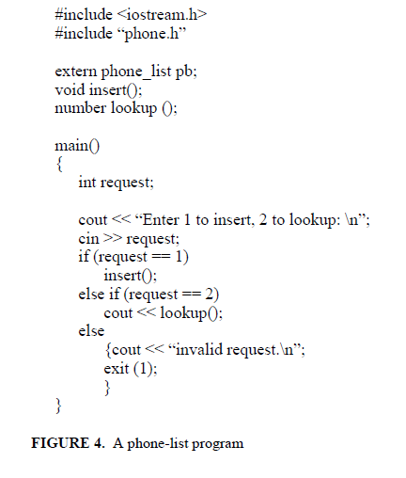
A simple program
Organization
Environment
Computation

Slide 118
Syntax and semantics
Syntax
State how to form expressions, statements, and programs that look right.

Slide 119
Semantic
The semantic rules tell how to build meaningful expressions, statements, and programs.
For example,
Before using the variable request in the if-statement, we must declare that variable.
Presence of the extern in the declaration of the variable pb indicates that the storage is reserved by some other module and not this one.

Slide 120
Semantic Elements
Variables
Values and references
Expressions
Program Organization

Slide 121
Variables
A variable corresponds to a region of memory which is used to hold values that are manipulated by the program.
Variable name
Syntactic rules
specify how variables may be named
declaration introduces a variable by giving it a name
Semantic Properties
Scope
Type
lifetime

Slide 122
Scope
What part of the program has access to the variable?
The location of the variable declaration determines the start of the scope of the variable.
TYPE
what kinds of values may be stored
what operations may be performed
Fundamental types- integer, real, character
User Defined types-

Slide 123
Lifetime
when is the variable created and when is it discarded?
when is a memory area reserved, or allocated….
when the program starts
declaration is encountered at execution time
unit in which the declaration occurs is entered
statement that explicitly requests the allocation of storage

Slide 124
Values and references
x = y;
l-value is a value that refers to a memory location, and, therefore, may be used on the left hand side of an assignment statement;
r-value is a value that refers to the contents of a memory location, that is, a value that may be used on the right-hand side of an assignment statement.
x=&y
3 = y; //error, left-hand side requires l-value
error because literals in C++ do not have l-values. Instead,
y = 3;

Slide 125
Expressions
syntactic constructs that allow the programmer to combine values and operations to compute new values.
request == 1, // expression of type boolean;
“invalid request.\n” // an expression of type string
a=b=c + d;
Some languages specify the order strictly, for example right-to-left,

Slide 126
Program organization
Programs consist of thousand line of code
C/C++ consists of a number of files
some files may contain modules referred as library
break a program into a number of independent parts- implemented and validated by different people
Program debugging and maintenance is also simplified
ability to compile separate parts of the program is important in writing large applications.
organization facilities provided by a programming language are dependent on the goals of the language

Slide 127
Program Data and Organization
Algorithms operate on some data to produce some results
Data : int x;
What is type of program?
What kind of value it may hold?
Where can such a variable declaration occur in a program?
When is the variable created?
Does it have an initial value?
Is it known to other procedures or modules of the program?
How can variables be exported to other modules?

Slide 128
Cont….. Data
To combine different data items mechanisms are..
e.g C++ provides arrays and records for building aggregate data structures
What are the kinds of components that a data structure may contain?
Can a function be an element of a record?
Pascal its NO and in C++ its YES

Slide 129
Computation
Expressions as a mechanism for computing values.
Control structures are used to structure more complicated computations.
Routine calls allow for the execution of a computation defined elsewhere in the program
Combining expressions, statements, control structures and routine calls allows to write algorithms.

Slide 130
External Environment
The data needed for program and the result are transferred to and from the program to external environment.
Some language provides specific constructs for input/output.
The programmer has a complete model of the environment and the compiler can do consistency checking.

Slide 131
Cont…
C/C++, rely on libraries external to the language.
e.g. iostream.h
This makes the language simpler and allows more flexibility.
Different libraries may be added as new devices, such as graphical libraries.

Slide 132
Syntax and Semantics

Slide 133
Language Definition
A language definition should enable a person or a computer program to determine
Whether a purported program is in fact valid?
If the program is valid, what its meaning or effect is.
SYNTAX
SEMANTICS

Slide 134
Syntax
A set of rules that define the form of a language: They define how sentences may be formed as sequences of basic constituents called words.
Whether a sentence is legal or not
Syntax does not tell us anything about the content (or meaning) of the sentence.
C syntax tells us how to combine such words to construct well formed statements and programs.

Slide 135
Syntax (Cont…)
Words (identifiers, numbers, operators) are constructed out of characters belonging to an alphabet.
The syntax of a language is defined by two sets of rules:
Lexical Rules
Syntactic Rules
both contribute to the “external” appearance of the language

Slide 136
Syntax (Cont…)
Lexical rules specify the set of characters that constitute the alphabet of the language and the way such characters can be combined to form valid words.
Pascal considers lowercase and uppercase characters to be identical, but C and Ada consider them to be distinct.
The lexical rules also tell us that <> (or ¦) is a valid operator in Pascal but not in C,

Slide 137
How to define the syntax of a language?
EBNF ( Extended Backus Naur Form)
Context free grammar for defining syntax of PL.
EBNF is a meta-language.
A meta-language is a language that is used to describe other languages.

Slide 138
Symbols of the metalanguage : ::=, <, >, *, +, (, ), |
Rules. For example, <program> ::= { <statement>* }
::= : “is defined as”
* : an arbitrary sequence of the previous elements
<program> is defined as an arbitrary sequence of <statement> within brackets “{” and “}”.
| : Choice

Slide 139
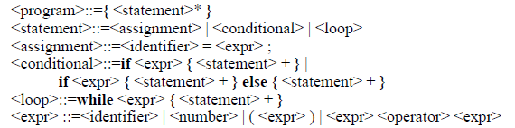
Syntax Rules

Slide 140
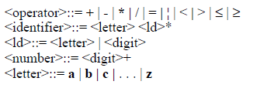
Lexical Rules
Know how to write a syntactically correct program.
To determine whether a program is syntactically correct.

Slide 141
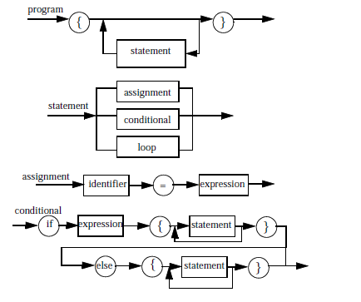
4.1 Language Definition

Slide 142
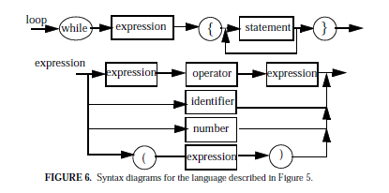
4.1 Language Definition

Slide 143
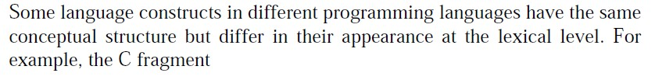
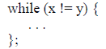
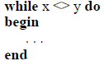
Syntax – Abstract syntax, Concrete syntax and Pragmatics

Slide 144
Cont…
Same abstract structure and differ only in lower-level details
When two constructs differ only at the lexical level, they follow the same abstract syntax.
Pragmatics : how constructs and features of a language may be used to achieve various objectives.
Notes:
Pragmatics is the third general area of language description, referring to practical aspects of how constructs and features of a language may be used to achieve various objectives. Consider, for example, the syntax, semantics and pragmatics of an assignment statement. As a syntactic construct, an assignment statement may consist of a variable and an expression (themselves syntactic constructs), separated by the token = as an assignment operator. Semantically, the variable denotes a location in computer memory, while the expression denotes computation of a value based on the contents of memory. Overall, the semantics of assignment is to perform the expression evaluation based on current memory contents and then update the value stored in the particular location corresponding to the variable. But what is often most interesting to programmers is really the pragmatics, that is, what assignment statements are useful for. There are many possibilities: to set up a temporary variable for the value of an expression that is needed more than once, to communicate values from one part of a program to another, to modify part of a data structure, or to set successive values of a variable used in some iterative computation.

Slide 145
SEMANTIC

Slide 146
Semantics
A syntactically correct program may contain semantic errors.
int vector [10];
Ten integer elements to be reserved for a variable
named vector.
if (a > b) max = a; else max = b;

Slide 147
Static and Dynamic Semantic
Static Semantic
Syntactically correct programs can be verified before a program’s execution
Dynamic Semantic
Describes the effect of executing the different constructs of the programming language.
Programs can be executed only if they are correct both with respect to syntax and to static semantics.

Slide 148
Introduction to formal semantics
Formal semantics of PL provides the basic mathematical techniques necessary for those who are beginning a study of the semantics and logics of programming languages
The ability to provide formal semantics makes language definitions independent from the implementation.

Slide 149
Formal semantics
Two ways of formally specifying semantics…
Axiomatic semantics and Denotational semantics
Axiomatic semantics-
Views a program as a state machine.
Programming language constructs are described by describing how their execution causes a state change.
Denotational semantics –
Main use is proving programs correct.
It proves that under certain specified constraints on input data, the program terminates in a final state satisfying a specified constraint on output data.

Slide 150
1. Interpretation 2. Translation 3. Concept of Binding
2. LANGUAGE PROCESSING

Slide 151
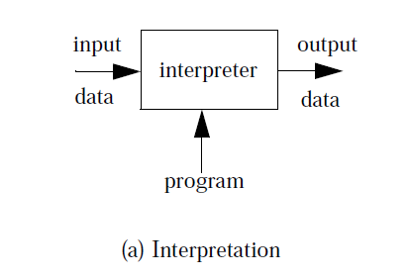
Interpretation
Statements are executed direly by host CPU.
without previously compiling a program into machine-language instructions.

Slide 152
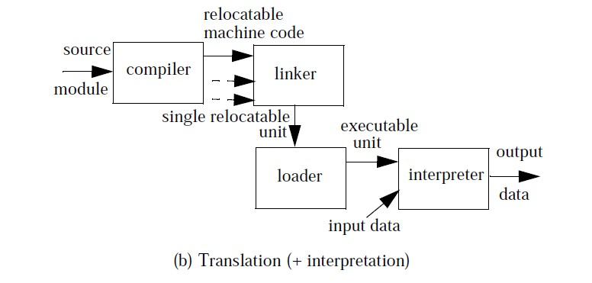
Translation

Slide 153
Interpreter | Compiler
Translates program one statement at a time. | Scans the entire program and translates it as a whole into machine code.
It takes less amount of time to analyze the source code but the overall execution time is slower. | It takes large amount of time to analyze the source code but the overall execution time is comparatively faster.
No intermediate object code is generated, hence are memory efficient. | Generates intermediate object code which further requires linking, hence requires more memory.
Continues translating the program until the first error is met, in which case it stops. Hence debugging is easy. | It generates the error message only after scanning the whole program. Hence debugging is comparatively hard.
Programming language like Python, Ruby use interpreters. | Programming language like C, C++ use compilers.

Slide 154
C Execution
The compilation and execution process of C can be divided in to multiple steps:
Preprocessing - Using a Preprocessor program to convert C source code in expanded source code. "#includes" and "#defines" statements will be processed and replaced actually source codes in this step.
Compilation - Using a Compiler program to convert C expanded source to assembly source code.
Assembly - Using a Assembler program to convert assembly source code to object code.
Linking - Using a Linker program to convert object code to executable code. Multiple units of object codes are linked to together in this step.
Loading - Using a Loader program to load the executable code into CPU for execution.

Slide 155
Cont..
1) C program (source code) is sent to preprocessor first. The preprocessor is responsible to convert preprocessor directives into their respective values. The preprocessor generates an expanded source code.
2) Expanded source code is sent to compiler which compiles the code and converts it into assembly code.
3) The assembly code is sent to assembler which assembles the code and converts it into object code. Now a simple.obj file is generated.
4) The object code is sent to linker which links it to the library such as header files. Then it is converted into executable code. A simple.exe file is generated.
5) The executable code is sent to loader which loads it into memory and then it is executed. After execution, output is sent to console.

Slide 156
Concept of binding
Program Entities: variables, routines, statements, and so on.
Properties of program entities called as Attributes.
For example, a variable has a name, a type, a storage area.
Values of attributes must be set before they can be used.
Setting the value of attribute is known as Binding.
Association between an attribute (property) and an entity or operation and a symbol.

Slide 157
Binding Time
Binding Time : The Time at which binding takes place is called binding time.
Language Definition Time
Implementation Time Static Binding (early)
Compile Time
Execution Time Dynamic Binding(Late)

Slide 158
1. Name and Scope 2. Type 3. l-value 4. r-value 5. Reference and unnamed variables
3. Variables

Slide 159
Variables
A variable corresponds to a region of memory which is used to hold values that are manipulated by the program.
A variable is a 5-tuple
<name, scope, type, l_value , r_value>
name is a string of characters used by program statements to denote the variable;
scope is the range of program instructions over which the name is known;
type is the variable’s type;
l_value is the memory location associated with the variable;
r_value is the encoded value stored in the variable’s location

Slide 160
Name and Scope
Variable’s name is introduced by ‘declaration’.
Scope of a variable is the range of program instructions over which the name is known.
Different programming languages adopt different rules for binding variable names to their scope.
Variables can be bound to a scope either statically or dynamically (Static and dynamic scope binding )

Slide 161
Static scope binding
Each reference to a variable can be statically bound
Example : APL, LISP and SNOBOL4
Dynamic scope binding
scope of a variable's name in terms of program execution
Example : C

Slide 162
Type
It is specification of the set of values that can be associated with the variable, together with the operations.
Values and operations are bound to a certain machine representation when the language is implemented.
User defined types or ADT ( Class in C++).
Static Type Checking
Dynamic Type Checking

Slide 163
Static Typing
Dynamic Typing
Bind variables to their type at compile time,
the binding cannot be changed during execution.
E. g. FORTRAN, COBOL, Pascal, C, C++, Modula- 2, and Ada
Binding between variables and their type at run-time.
Also called “polymorphic variables”
E.g. Assembly languages, LISP, APL, SNOBOL4, and Smalltalk

Slide 164
l-value and r-value
The l_value of a variable is the storage area bound to the variable during execution.
The r_value of a variable is the encoded value stored in the location associated with the variable.
Program instructions access variables through their l_value and possibly modify their r_value.
Pascal and C differ in the time of binding between the const variable

Slide 165
Routines
Procedures take zero or more arguments, and then do something.
– e.g printf(“Hello”), exit,
Functions take zero or more arguments, and return a value of a given type
– e.g. X = sqrt(4), r = random(), fp = open(“foo”)

Slide 166
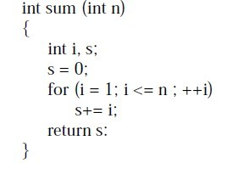
Routines -Elements
Name of the declared procedure
A body consisting of local declarations and statements
Formal parameters which are replaced by actual parameters
Result type – return type

Slide 167
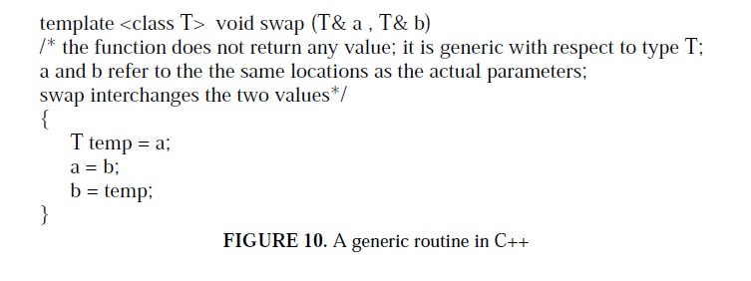
Routines -Generic Routines

Slide 168
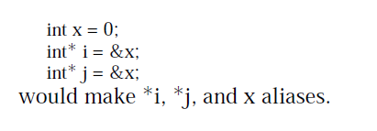
Routines -Aliasing and Overloading
Overloading- Operator and Function Overloading
– E.g. printf(“%d”, &a);
printf(“Hello World”);
Aliasing : Aliasing is exactly the opposite of overloading. Two names are aliases if they denote the same entity at the same program point.

Slide 169
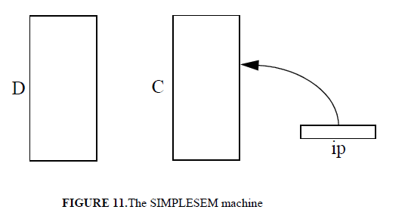
Abstract Semantic Processor
D = data memory C = Code memory
ip = instruction pointer

Slide 170
Abstract Semantic Processor (Cont..)
Instruction Pointer: the reference to the instruction currently being executed.
Memory: the instructions to be executed and the data to be manipulated are stored
Processor.
The instruction pointer (ip) is always used to point to a location in C; it is initialized to 0.
code memory (C)
Data memory (D)

Slide 171
Abstract Semantic Processor (Cont..)
Set (To modify value stored in a cell)
set 10, D[20] : assign the value stored at location 20 into location 10.
set 15, read: value read from the input device is to be stored at location 15;
set write, D[50] : value stored at location 50 is to be transferred to the output device.

Slide 172
Abstract Semantic Processor (Cont..)
jump (jump to a certain instruction)
jump 47 :instruction stored at address 47 of C to be the next instruction to be executed; sets ip to 47
Jumpt (conditional jump, which occurs if an expression evaluates to true)
jumpt 47, D[3] > D[8] : jump occurs only if the value stored in cell 3 is greater than the value stored in cell 8.

Slide 173
Run time structure - C

Slide 174
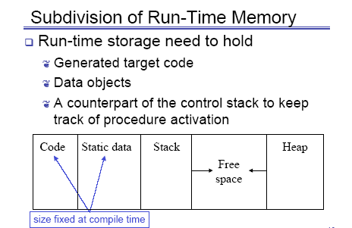
Run-time structure

Slide 175
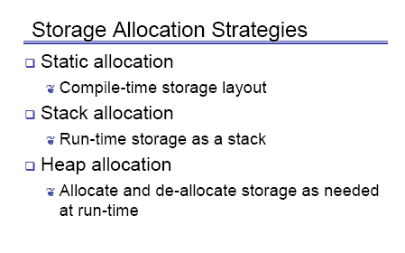
Run-time structure
Chhaya Gosavi CCEOW

Slide 176
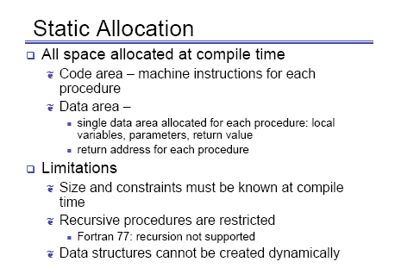
Run-time structure
Chhaya Gosavi CCEOW

Slide 177
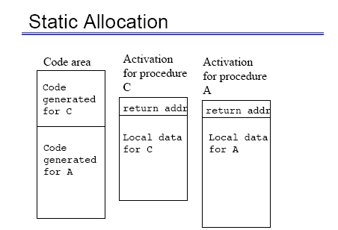
Run-time structure
Chhaya Gosavi CCEOW

Slide 178
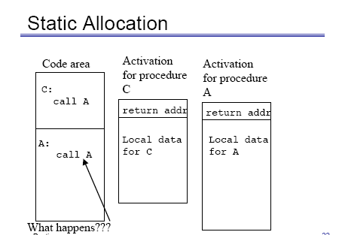
Run-time structure
Chhaya Gosavi CCEOW

Slide 179
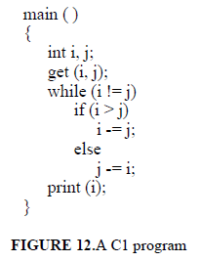
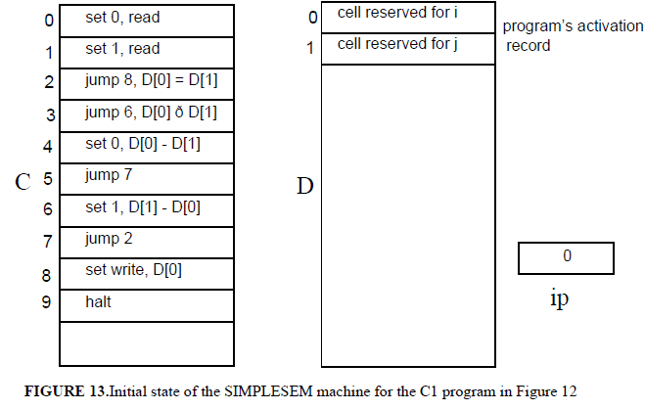
C1: A language with only simple statements

Slide 180
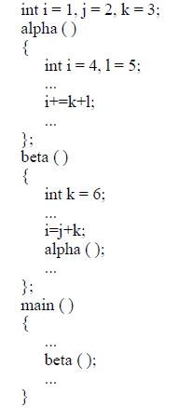
C2: Adding simple routines
set of data declarations (global data);
• set of routine definitions and or declarations;
• a main routine (main ( )), which contains its local data declarations and a set of statements,
that are automatically activated when the execution starts. The main routine cannot be
called by other routines.
Main routine gets called
initially, and causes routines beta and alpha to be called in a sequence

Slide 181
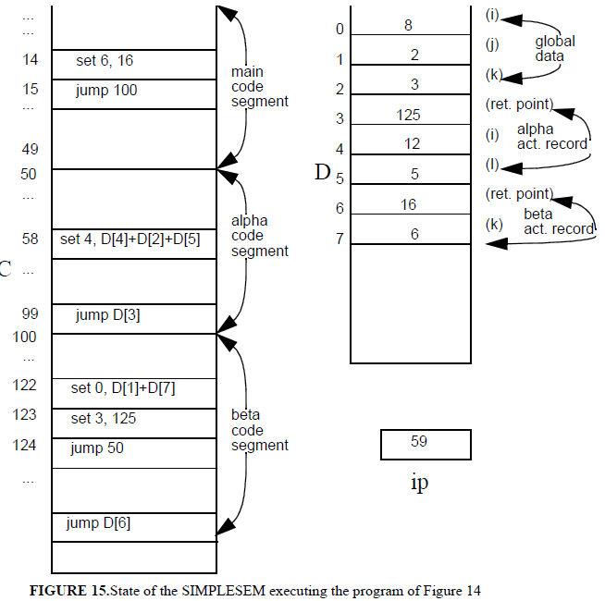

Slide 182
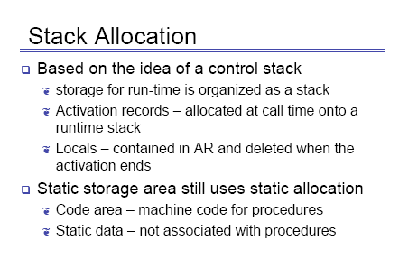
Run-time structure
Chhaya Gosavi CCEOW

Slide 183
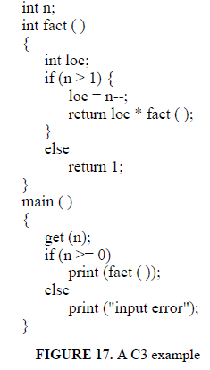
C3: Supporting recursive functions
In order to support mutual recursion between two routines–say, A and B–the program must be written according to the following pattern:
A’s declaration (i.e., A’s header);
B’s definition (i.e., B’s header and body);
A’s definition;

Slide 184
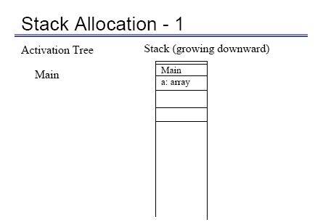
Run-time structure
Chhaya Gosavi CCEOW

Slide 185
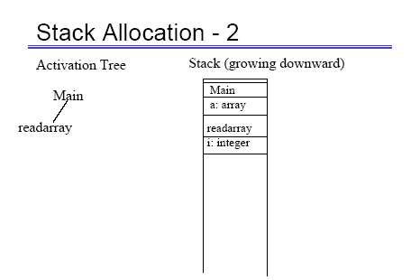
Run-time structure
Chhaya Gosavi CCEOW

Slide 186

Run-time structure
Chhaya Gosavi CCEOW

Slide 187

6.1 Run-time structure
Chhaya Gosavi CCEOW

Slide 188

Run-time structure
Chhaya Gosavi CCEOW

Slide 189

Run-time structure
Chhaya Gosavi CCEOW

Slide 190

Run-time structure
Chhaya Gosavi CCEOW

Slide 191

Run-time structure
Chhaya Gosavi CCEOW

Slide 192

Run-time structure
Chhaya Gosavi CCEOW

Slide 193

Run-time structure
Chhaya Gosavi CCEOW

Slide 194

Activation Records

Slide 195
Parameter passing
Call by Reference
Call by Copy
call by value,
Call by by result, and
Call by value-result

Slide 196


Slide 197
Call by result
Local variables corresponding to formal parameters are not set at subprogram call, but their value, at termination, is copied back into the corresponding actual parameter's location within the environment of the caller.
Call by result does not permit any flow of information from the caller to the callee.
Out params in CORBA

Slide 198

Chhaya Gosavi

Slide 199

Used in Algol
Chhaya Gosavi

Slide 200
Thank YOU

